Slide 1
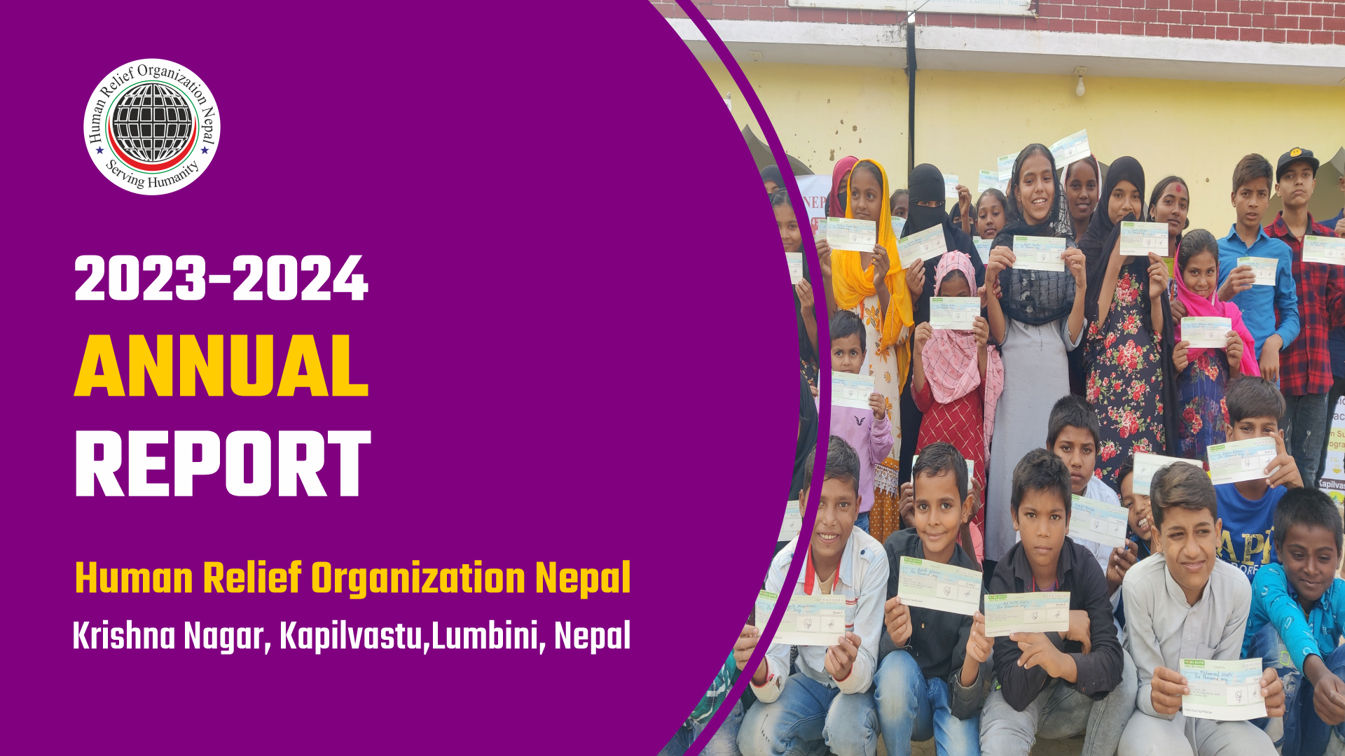

Slide 2
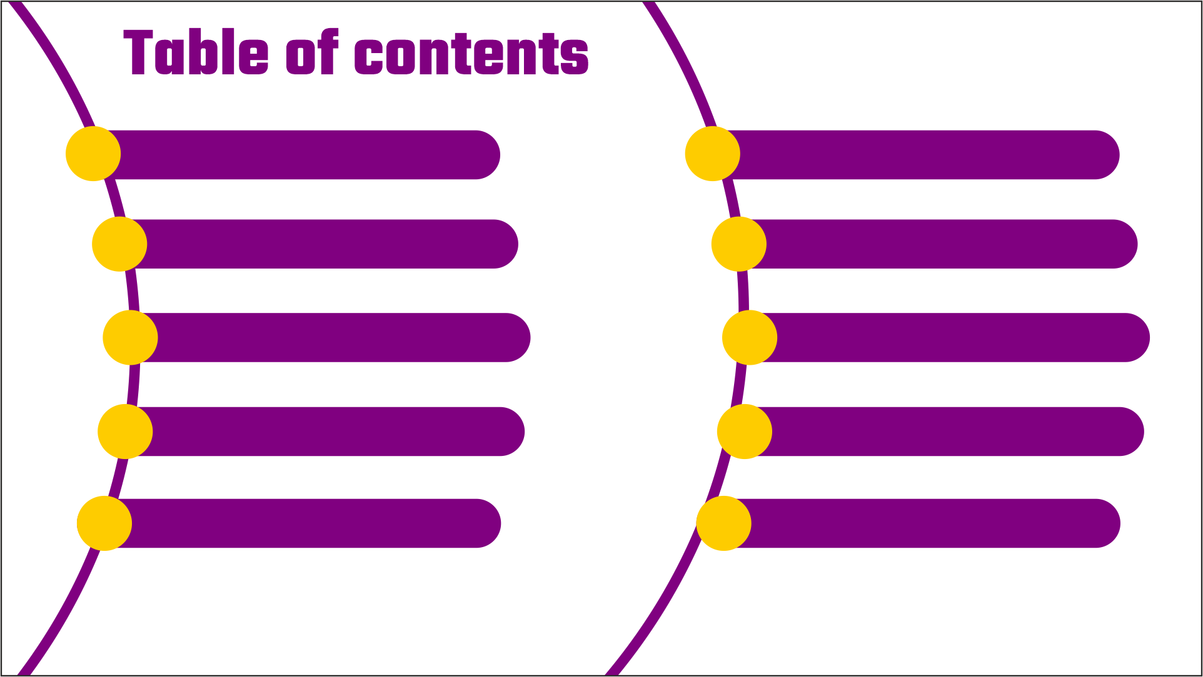
Message from Secretary General
Focus Areas
Country Context
Highlights 2023-24
Who We are
Financial Review
Geographic Intervention
Our Partners
Impact at Glance
HRO Nepal Contribution in SDG Goals

Slide 3
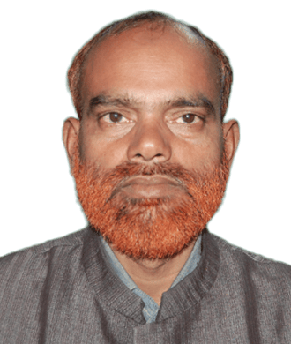
Message from the Secretary General
Ghufran Ahmad Shakir
It is with immense gratitude and deep humility that I extend my heartfelt appreciation to all who have supported Human Relief Organization Nepal (HRO Nepal) on our journey to serve humanity. Since our inception, our unwavering commitment has been to uplift the most vulnerable members of society and respond to human suffering with compassion, dignity, and purpose.
At HRO Nepal, we believe that the true strength of a nation lies in the well-being of its people. Guided by our mission and core values, we continue to work tirelessly to provide access to quality education, empower youth and women through skill development, support orphaned and destitute children, improve healthcare, ensure clean water access, and offer emergency relief in times of crisis. Every initiative we undertake is fueled by the desire to bring hope, opportunity, and dignity to those in need — all for the pleasure of God.
I am deeply proud of our dedicated team, volunteers, and community leaders who work selflessly, often under challenging circumstances, to make a meaningful difference. Your unwavering dedication is the cornerstone of our success and the driving force behind the positive change we strive to achieve.
We are equally grateful to our partner organizations and donors across the globe. Your trust, support, and collaboration empower us to expand our reach and maximize our impact.
Together, we have turned compassion into action — and together, we will continue building a better, more inclusive, and resilient Nepal.
As we look ahead, let us reaffirm our shared commitment to serve humanity with sincerity, transparency, and love. I invite everyone — individuals, institutions, and allies — to join hands with HRO Nepal in our mission to create a future where every life is valued and no one is left behind.
May God (SWT) continue to guide and bless our efforts.
Warm regards,

Slide 4
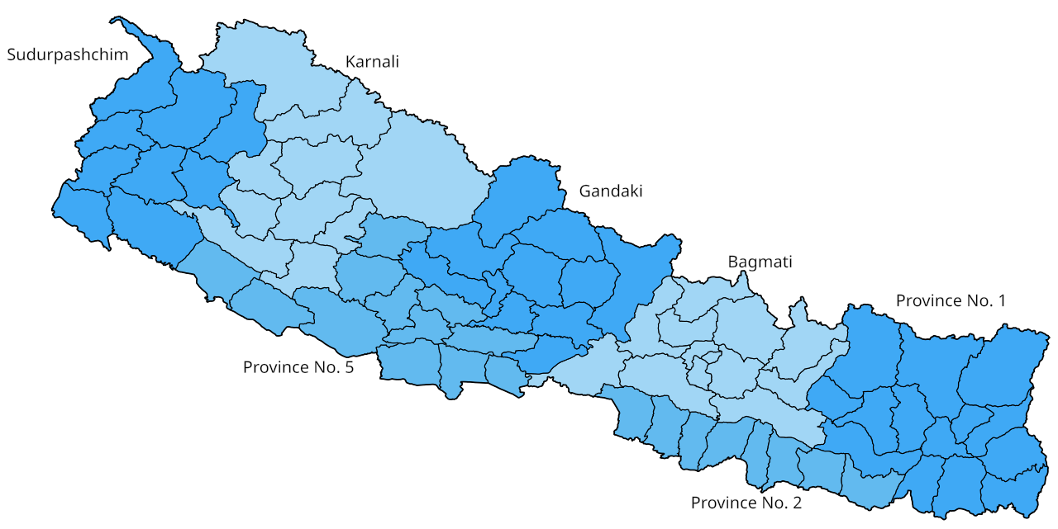
Country Context
Nepal is a culturally rich, multi-ethnic, and multi-religious country in South Asia, renowned for its natural beauty and diversity. In 2015, the country adopted a new Constitution, officially transitioning into a Federal Democratic Republic. This restructured Nepal into seven provinces, 77 districts, and 753 local-level rural and urban municipalities. The Constitution provides significant autonomy to local governments in areas of planning, resource allocation, and decision-making—creating opportunities for inclusive and sustainable development.
Importantly, the Constitution also upholds Gender Equality and Social Inclusion (GESI) principles, offering historically marginalized groups—including women, youth, and ethnic minorities—greater representation in governance, development, and economic spheres. Despite this progressive framework, Nepal continues to face major development challenges. Gaps in policy clarity, implementation mechanisms, and coordination among government tiers have hampered the effectiveness of development efforts. While infrastructure development has been prioritized, social development—especially in health, education, and child protection—remains under-addressed. Community schools often lack child-friendly environments, leading to poor learning outcomes. Although school enrollment rates are relatively high, dropout rates remain significant, particularly in higher grades. Youth unemployment is another pressing concern, driving mass labor migration abroad. Access to quality healthcare, water, and sanitation remains limited—particularly among marginalized communities in remote regions. These disparities contribute to elevated maternal and child mortality rates and widespread malnutrition. In agriculture, limited adoption of modern technologies and commercial practices has resulted in low productivity. Additionally, frequent natural disasters—such as floods, landslides, fires, thunderstorms, and epidemics—pose ongoing threats to lives, livelihoods, and development gains. Nepal’s diversity is both its strength and its challenge. Addressing the country’s multifaceted development needs will require well-coordinated, inclusive, and resilient efforts from all levels of government, civil society, and development partners.

Slide 5


Who we are
Human Relief Organization Nepal (HRO Nepal) is a dedicated non-governmental, non-commercial entity committed to enhancing the lives of marginalized communities across Nepal. With a focus on creating sustainable and positive change, HRO Nepal operates through a diverse array of social, educational, and healthcare initiatives. The organization is steadfast in its mission to ensure access to quality education, support orphans and destitute children, empower youth through skills development, provide clean water, address malnutrition and food insecurity, offer free medical services, support healthcare facilities, and respond to crises and natural disasters. By tackling these critical areas, HRO Nepal strives to uplift communities and foster a brighter, healthier future for all.
Vision: As a leader to empower lives, creating opportunities and strengthen the bond of humanity.
Mission: HRO Nepal is committed to serve humanity by integrating resources for people in need. We strive to provide immediate response in disasters, and effective programs in place of suffering for the pleasure of Almighty God.
Goal: To uplift and transform the lives of marginalized and vulnerable communities across Nepal by providing integrated social, educational, and healthcare services, promoting self-reliance, and fostering sustainable development for the pleasure of Almighty God.
Core Values:
Mutual Respect: Recognize the innate worth of all people and the value of diversity
Equity and Justice: Work to ensure equal opportunity for everyone, irrespective of race, gender, color, class, ethnicity, disability and location
Care for All: Provide care for vulnerable groups; orphans, widows and elderly people
Honesty and Transparency: Being accountable at all levels for the effectiveness of our actions and open in our judgments and communications with others
Self -Respect: To help the poor without the feeling of humiliation
Solidarity with the Poor: Powerless and excluded will be the only bias in our commitment to the fight against poverty

Slide 6

Objectives
1
Promote Inclusive and Quality Education
4
Improve Access to Clean and Safe Water
7
Combat Malnutrition and Food Insecurity
2
Support Orphans and Destitute Children
5
Provide Free Medical Services and Surgeries
8
Deliver Emergency Relief and Disaster Response
3
Enhance Livelihoods through Skills Development
6
Strengthen Healthcare Infrastructure
9
Foster Community Resilience and Solidarity

Slide 7



Legal Status
Human Relief Organization Nepal is officially registered with the District Administration Office, Taulihawa, Kapilvastu under Registration No. 107/054-55. It is affiliated with the Social Welfare Council (Affiliation No. 32654) and is also registered with the Internal Revenue Office, Kapilvastu, under PAN No. 300363568.
Our Focus Areas
Geographic Intervention
In the fiscal year 2023–2024, Human Relief Organization Nepal positively impacted the lives of over (15,863) individuals across three districts (Kapilvastu, Rupendehi and Jajakot) in Nepal through a wide range of humanitarian and development interventions.
Despite operating in complex and often unpredictable environments, the organization remained steadfast in its commitment to uplifting communities facing poverty, displacement, and crisis.
Our dedicated teams worked tirelessly to adapt to evolving needs, delivering timely and essential support to the most vulnerable populations. Through this unwavering effort, HRO Nepal not only responded to emergencies but also laid the groundwork for long-term resilience and sustainable development.
Education for All
Orphan and destitute children Support
Skills development & Livelihood
WASH
HealthCare
Seasonal projects
Emergency Response

Slide 8
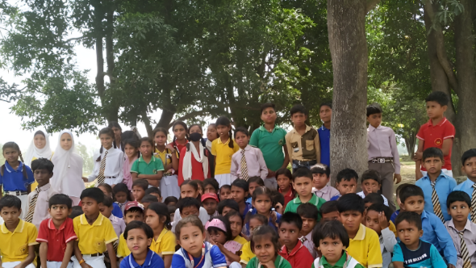

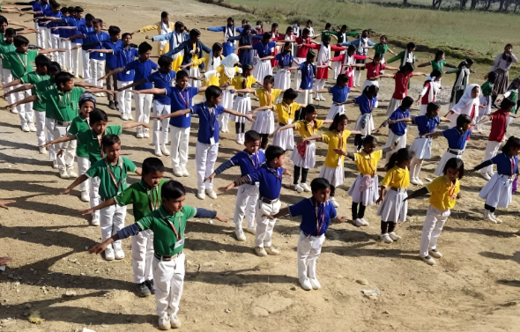
Highlights 2023-2024
Sahara Public Secondary School
Education remains at the heart of Human Relief Organization Nepal’s mission. We firmly believe that every child—regardless of their background—deserves the opportunity to learn, thrive, and realize their full potential. Through our Education Project, we extend scholarships, sponsorships, and academic support to underprivileged children, including orphans, children with disabilities, and those from marginalized and low-income communities.
key milestone this year has been our continued support to Sahara Public Secondary School, located in Krishnanagar, Kapilvastu, Nepal. To date, a total of (251) students have been provided with access to quality education at the school. This achievement reflects our commitment to breaking the cycle of poverty through education and empowering young minds with the knowledge, skills, and confidence needed to build a brighter and more self-reliant future.
Education For All

Slide 9
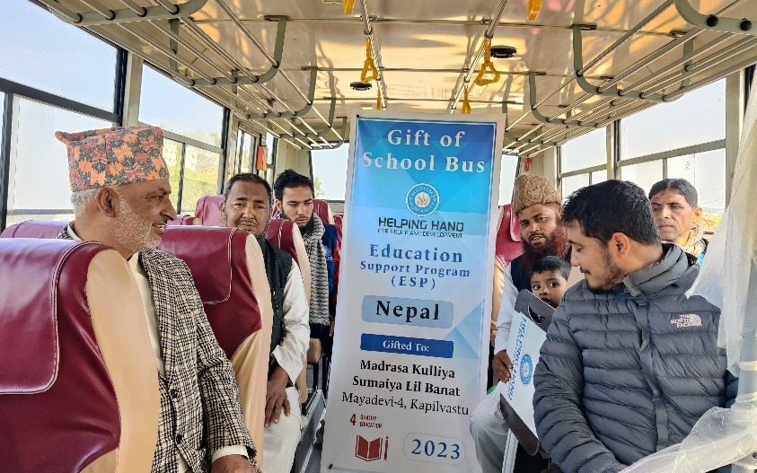
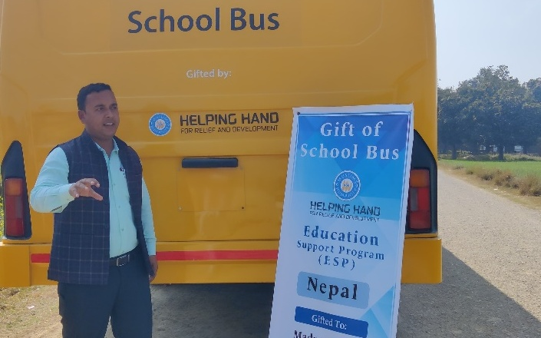
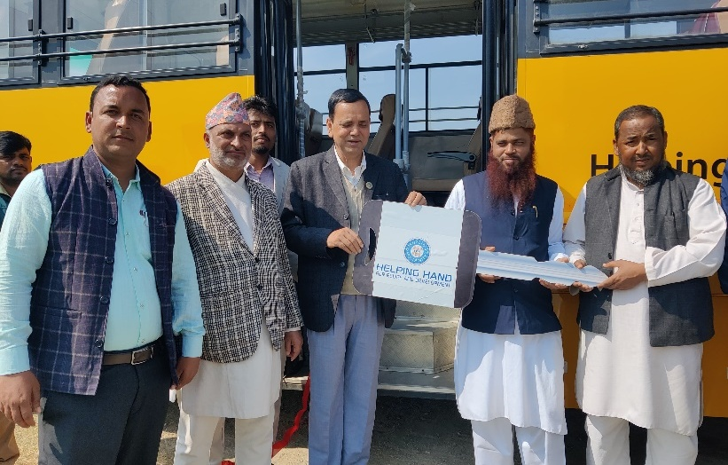
Gift of School Bus
In a significant step toward promoting inclusive and accessible education, Human Relief Organization Nepal provided a school bus to Madrasa Kulliya Sumaiya Lill Banat, located in Mayadevi Rural Municipality–04, Bulakdihwa, Kapilvastu District. This initiative was designed to ease the transportation challenges faced by students—particularly girls—who previously had to walk long distances to attend school.
The introduction of the school bus has brought remarkable improvements in access to education for children from remote and underserved areas. It has contributed to increased school attendance and punctuality, while also ensuring safer and more reliable travel for students. Each day, (865) girl students from surrounding villages use this bus service to commute to and from school, greatly enhancing their opportunities for learning.
The initiative has been warmly welcomed by the school administration, students, and parents, and it stands as a testament to our continued commitment to education and child protection in vulnerable communities.

Slide 10
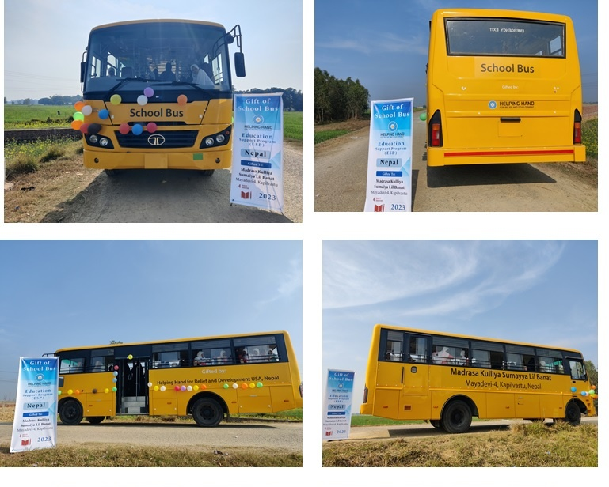
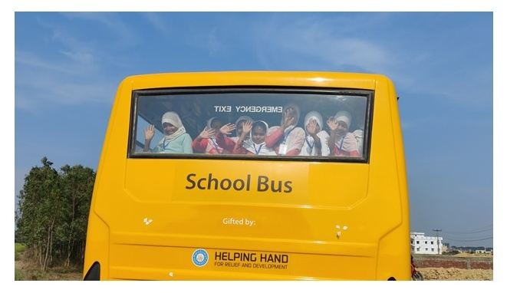

Slide 11
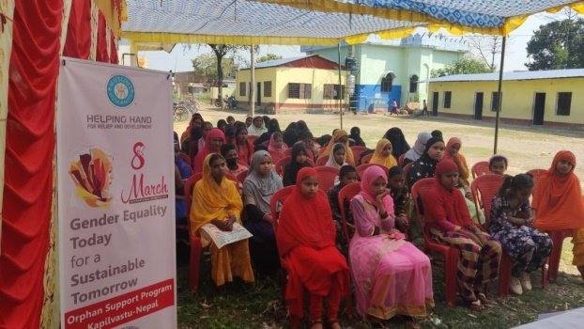

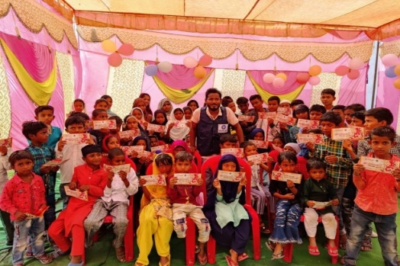
Orphan Support Program
HRO Nepal continues to prioritize the well-being of orphaned children through its Orphan Support Program (OSP), which provides holistic care with a focus on education, health, and emotional support. This year, a total of (200) orphaned children benefited from the program, receiving regular financial assistance, nutritious food packages, hygiene kits, school supplies, and educational materials to meet their daily and academic needs.
Seasonal initiatives such as “Winter – A Gift of Warmth” and “Festival Eid Cash Gifts” brought joy and inclusion during special occasions. In addition, the program organized regular health check-ups, educational tours, co-curricular activities, tree plantation drives, and interactive sessions with OSP mothers—strengthening family care and enhancing emotional well-being.
Through this program, HRO Nepal remains deeply committed to nurturing orphaned children in a safe and supportive environment, empowering them to grow into confident, capable, and resilient individuals.

Slide 12
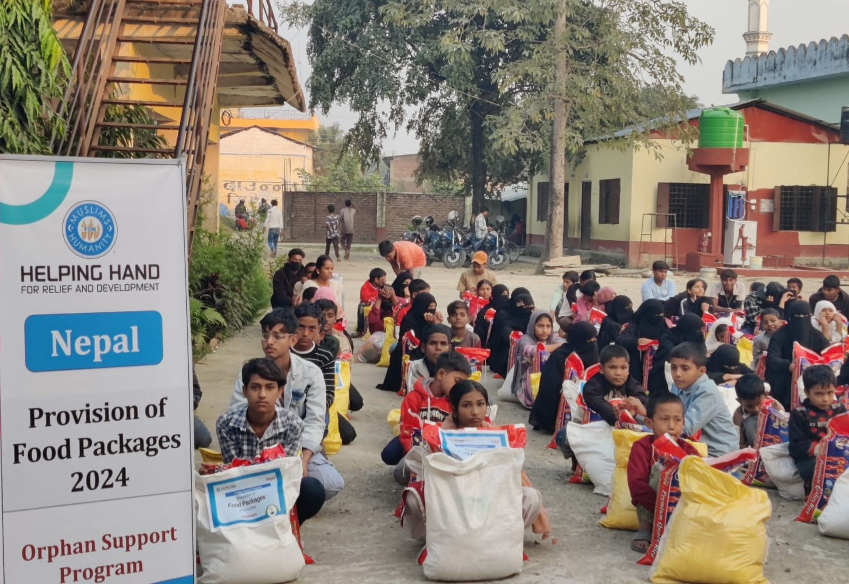
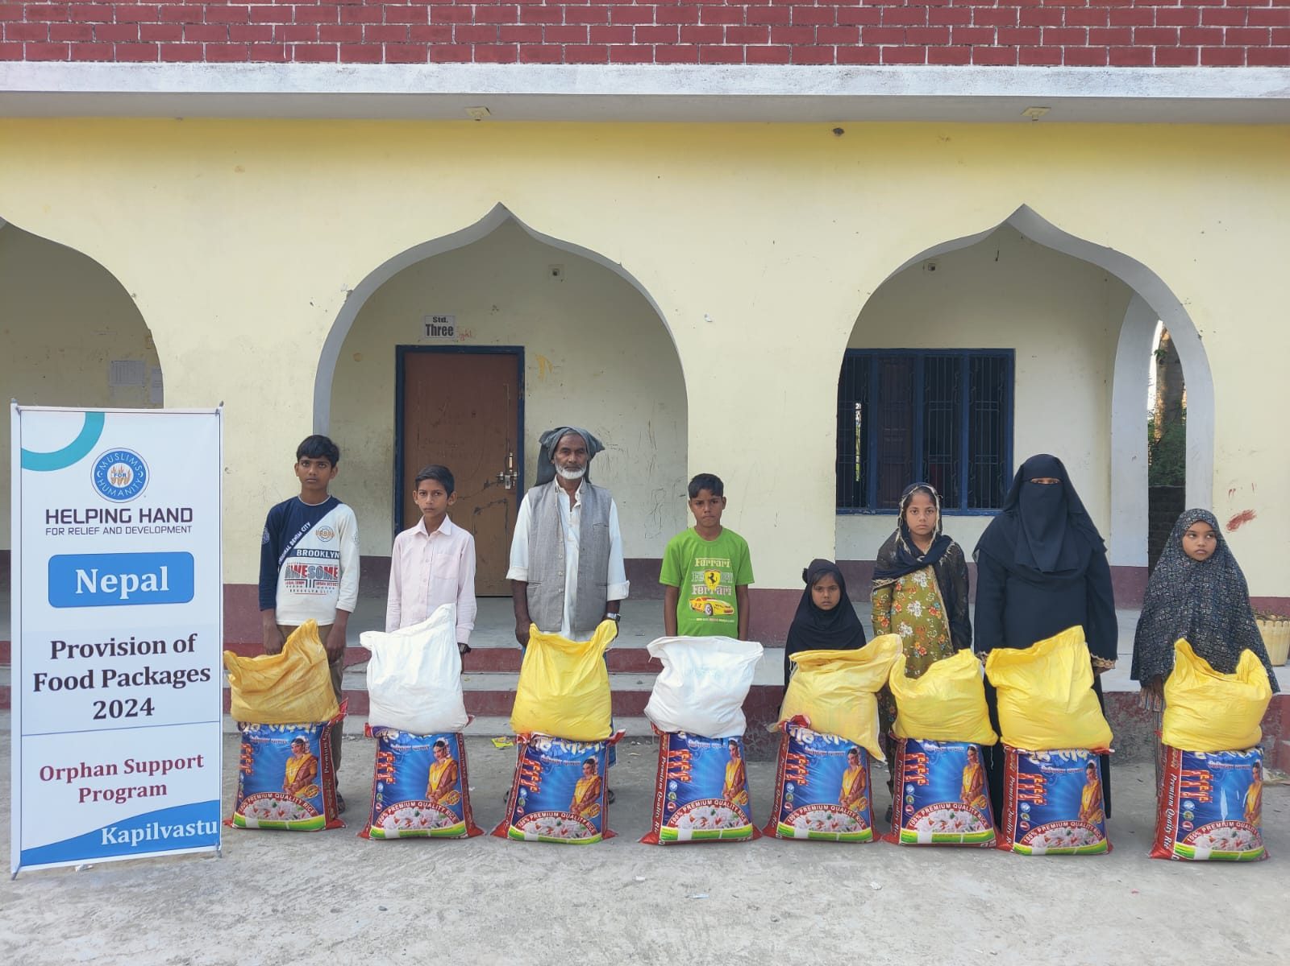
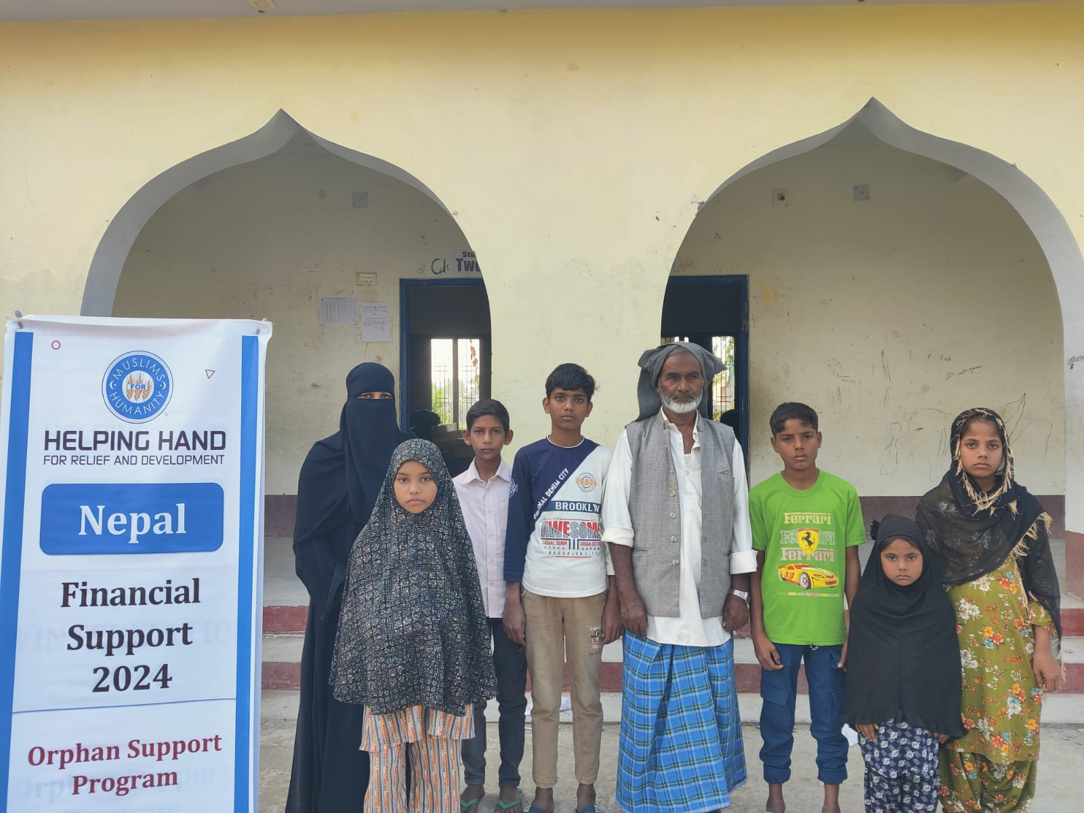
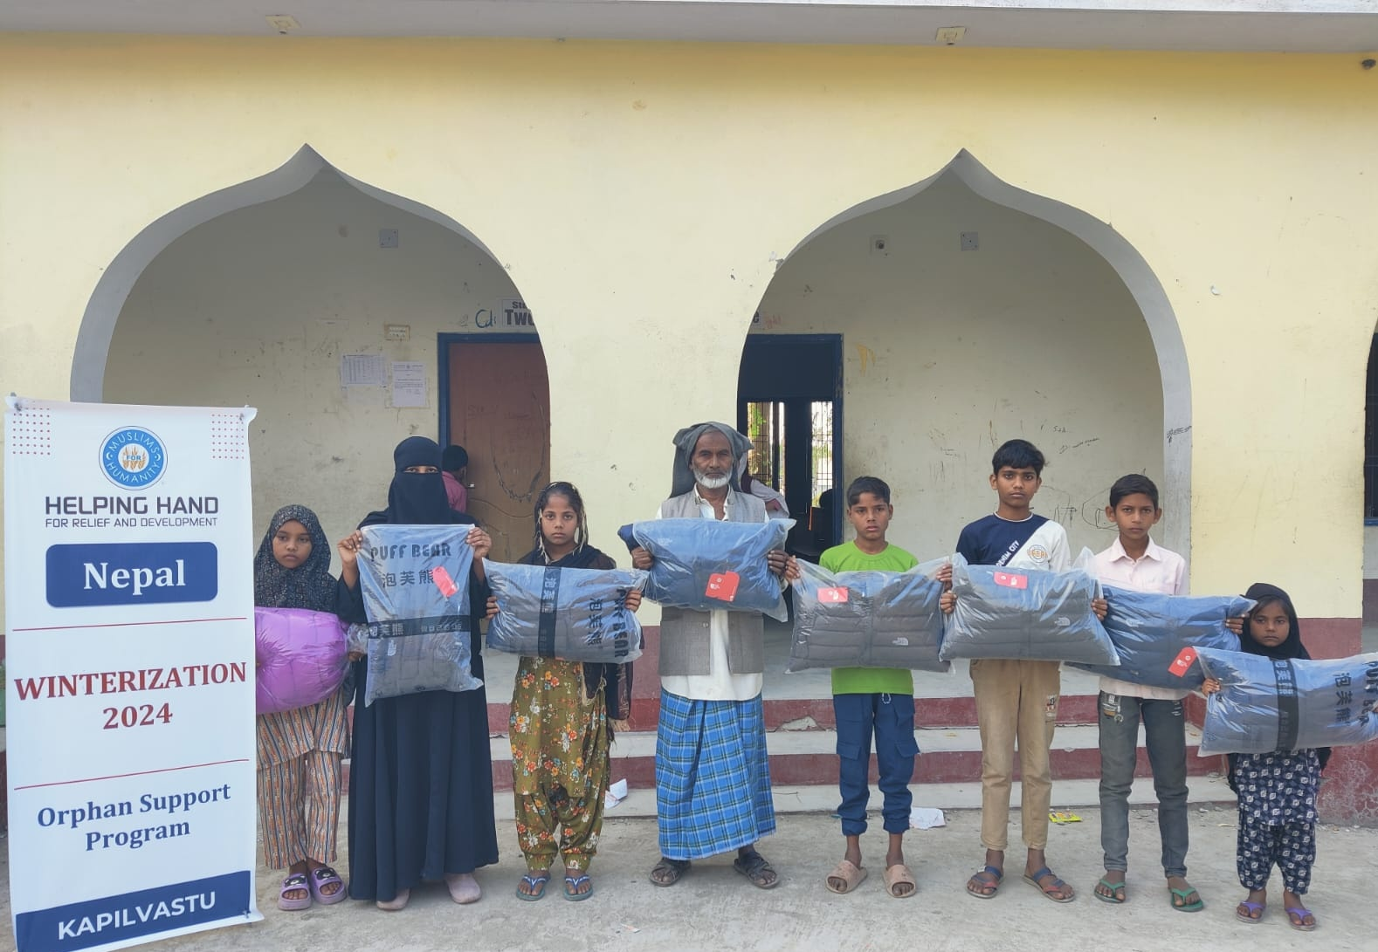
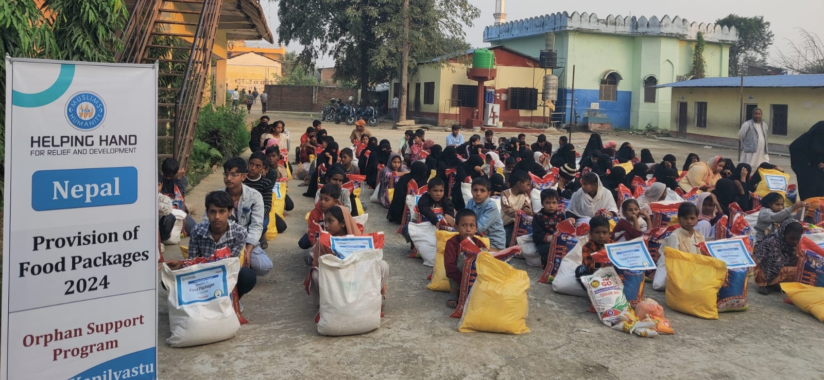

Slide 13

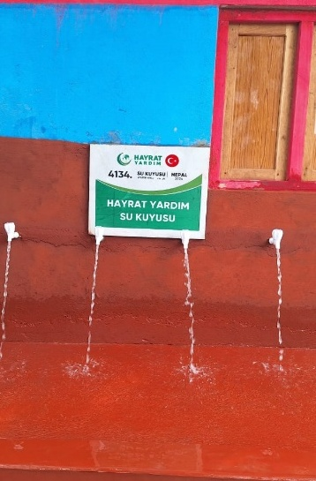
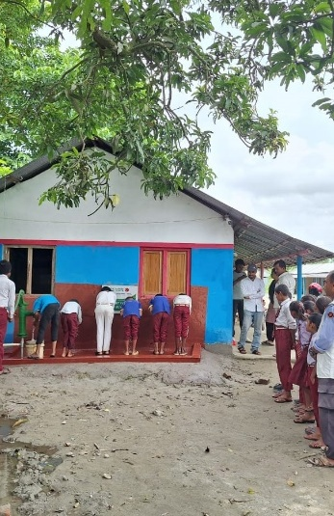
WASH – Water for Life
Access to safe and clean drinking water remains a pressing challenge in many parts of Nepal. To address this critical need, HRO Nepal has been implementing the Water for Life project, ensuring sustainable access to purified drinking water for underserved communities. This initiative has directly benefited (836) students, teachers, community members, and households—contributing to improved health, hygiene, and overall well-being.
In the past year, HRO Nepal expanded its efforts by installing water purification systems and promoting hygienic water management practices. These interventions have had a transformative impact, particularly in remote and marginalized areas, where access to clean water is most limited. Alongside infrastructure improvements, community education on safe water use and hygiene has strengthened the long-term sustainability of the project.
HRO Nepal remains firmly committed to advancing water, sanitation, and hygiene (WASH) initiatives, recognizing their essential role in protecting public health, upholding dignity, and improving the quality of life for vulnerable populations.

Slide 14
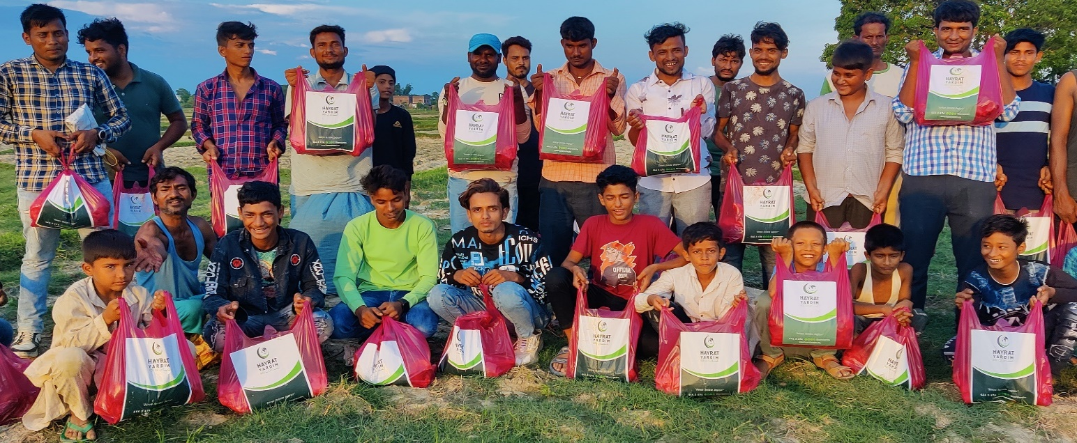

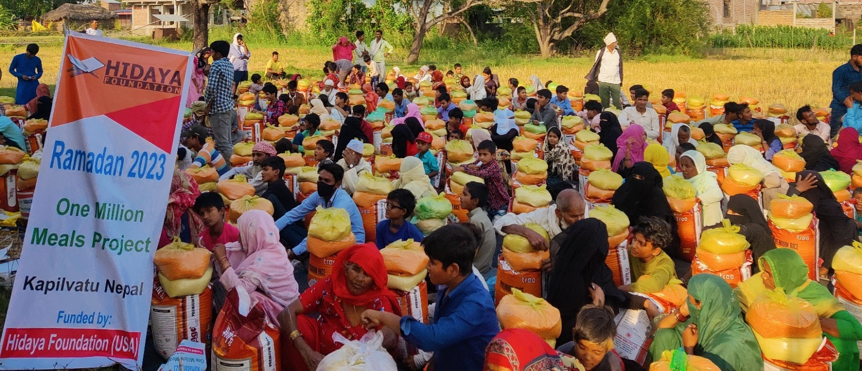
Seasonal projects
HRO Nepal continues to respond to urgent needs through its seasonal projects, providing timely relief and support during natural disasters, crises, and periods of hardship. These initiatives play a vital role in alleviating suffering and restoring dignity among vulnerable populations.
During the year, HRO Nepal carried out impactful seasonal initiatives, including the Ramadan Food Basket and Iftar Meals Program. Through these programs, essential food packages were distributed to vulnerable families and orphaned children across multiple regions, ensuring they could observe the holy month of Ramadan with dignity, proper nourishment, and a sense of communal support. In total, (3,155) individuals directly benefited from these efforts

Slide 15
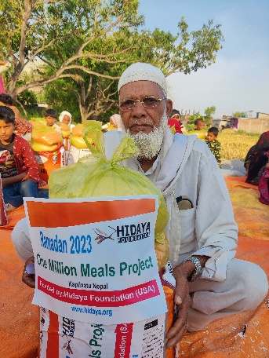
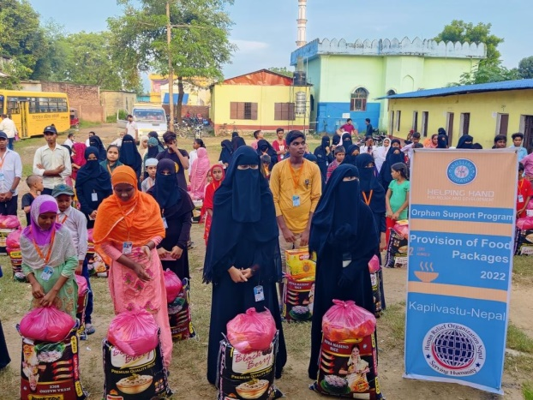
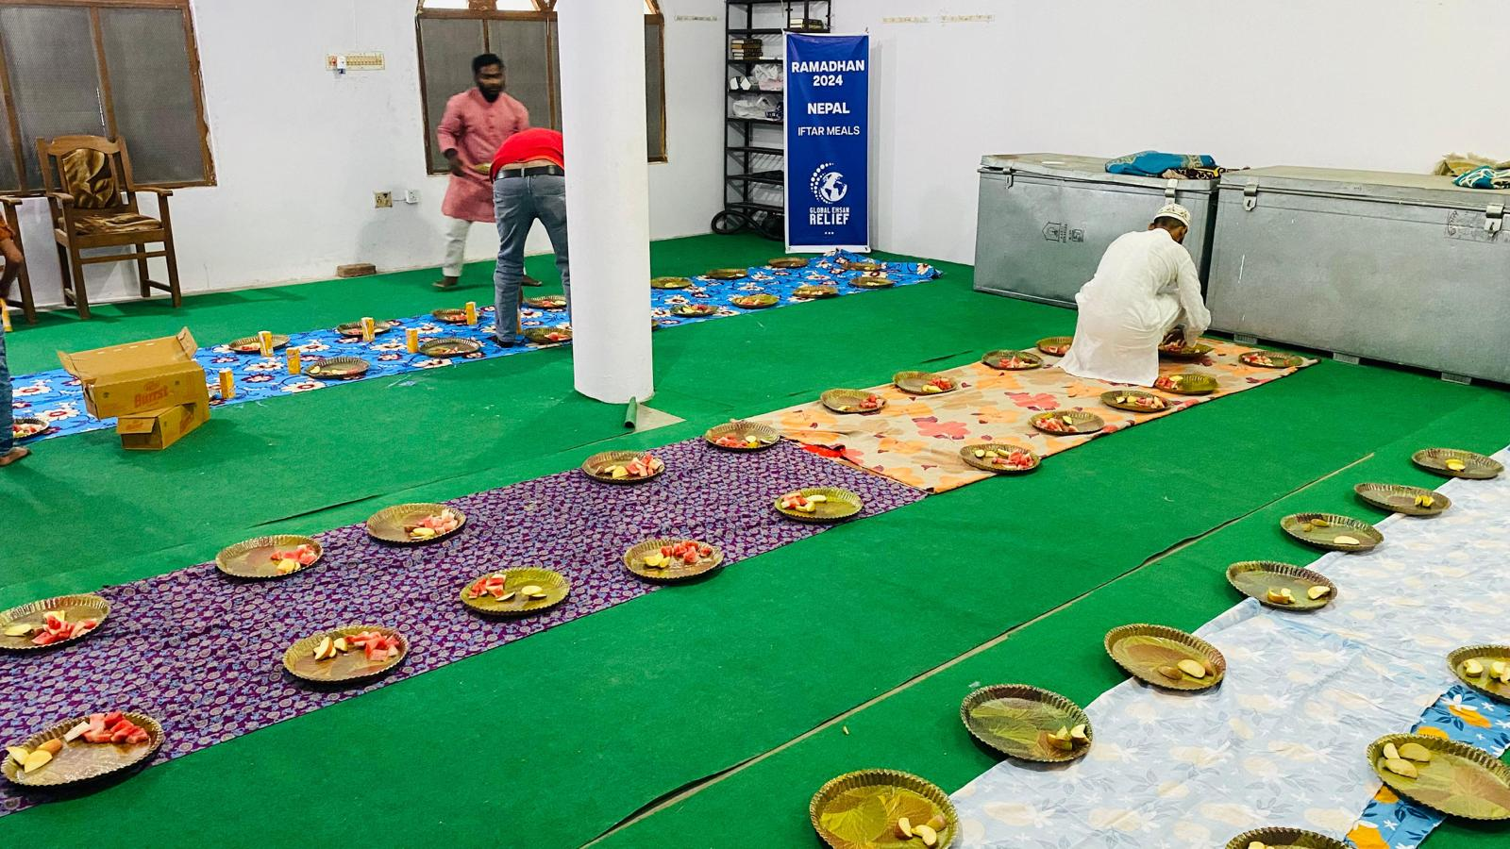
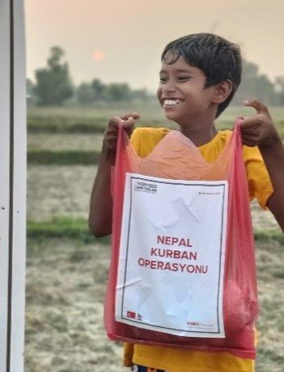
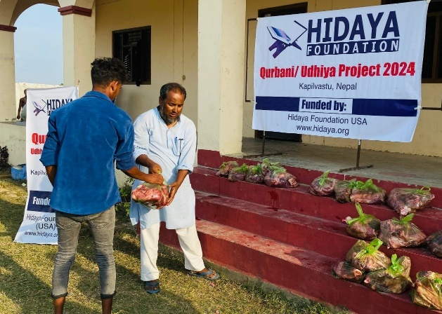
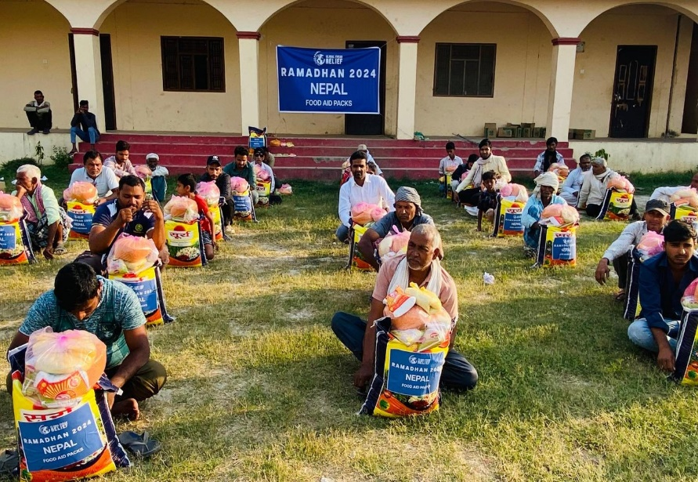
The Qurbani Meat Distribution Project brought both joy and nutritional support to underprivileged families during the Eid al-Adha celebration. Freshly slaughtered Qurbani meat was distributed to those in need, enabling them to partake in the religious occasion with dignity and inclusion. A total of (5,431) individuals benefited from seasonal Projects.
Through such seasonal efforts, HRO Nepal reaffirms its commitment to standing alongside communities in times of need—offering hope, relief, and solidarity. We warmly invite our partners and supporters to continue joining hands with us in transforming lives and fostering resilience across Nepal.

Slide 16
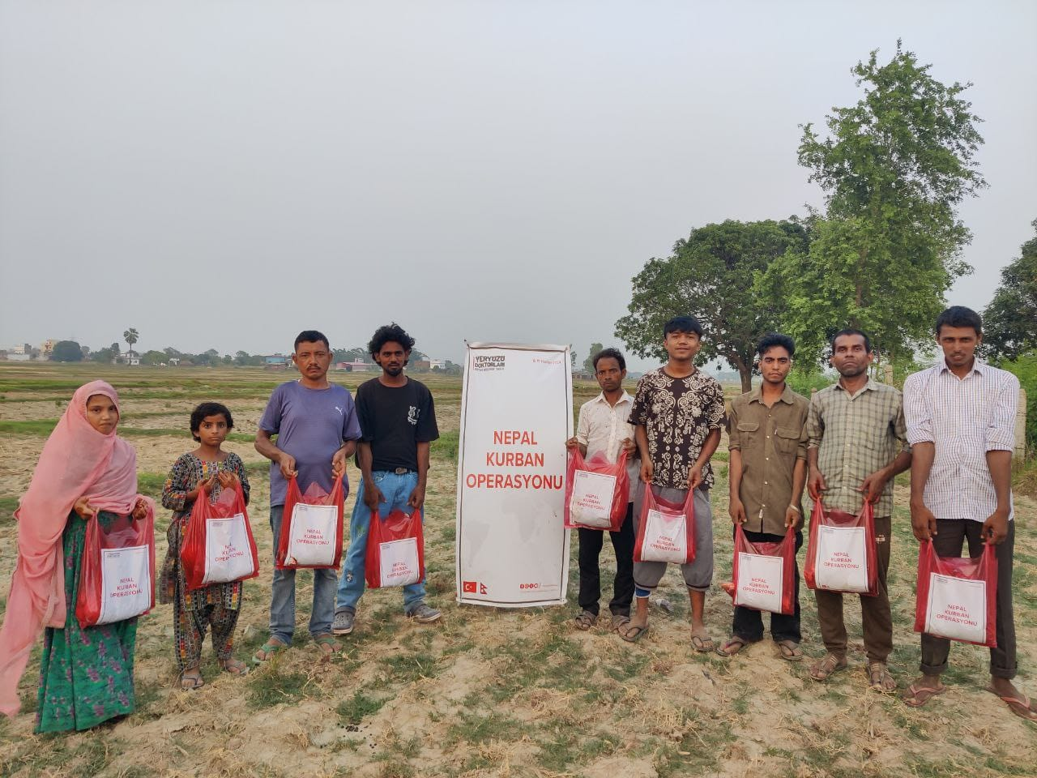
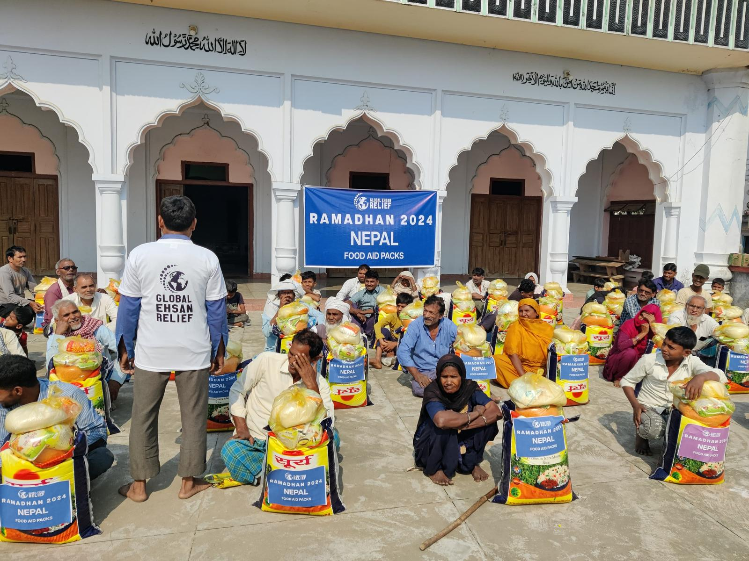
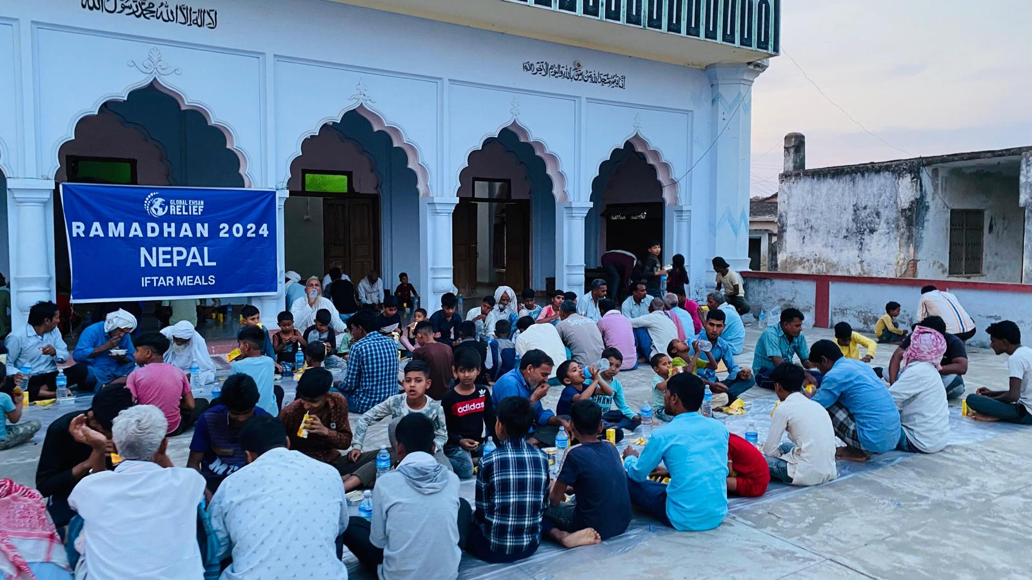

Slide 17

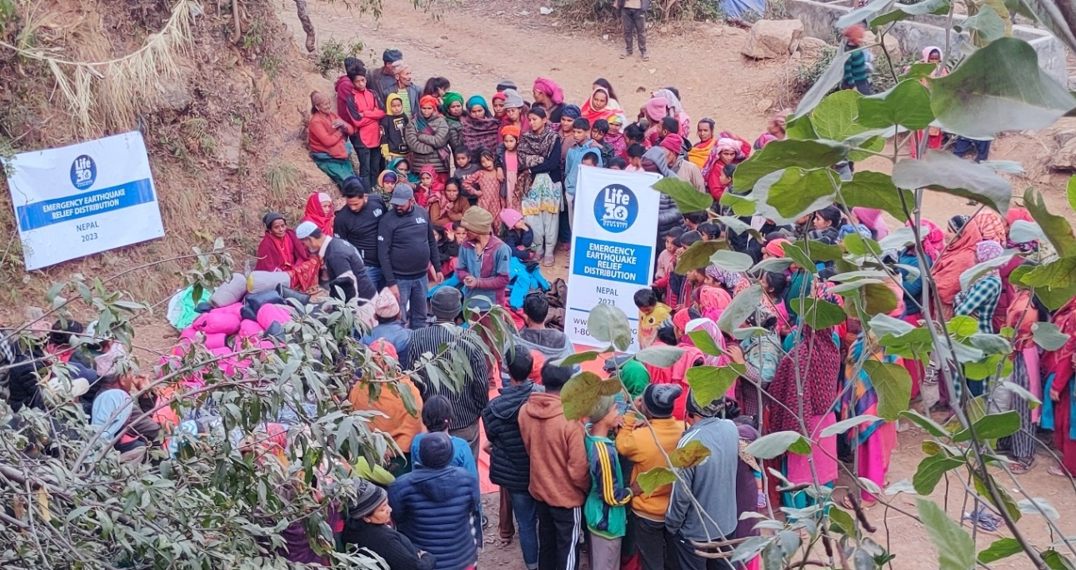
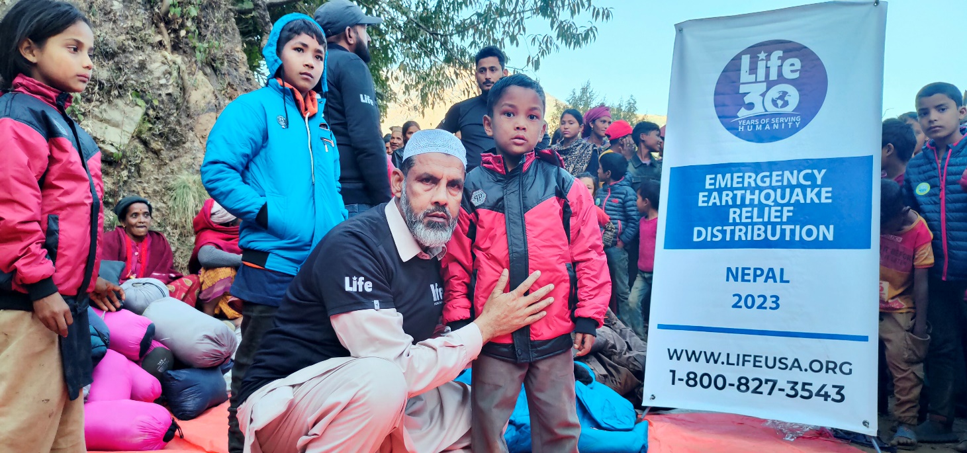
Emergency Earthquake Relief Distribution Nepal 2023
Nepal is highly vulnerable to natural disasters, especially earthquakes, landslides, and floods. Recognizing this reality, Human Relief Organization (HRO) Nepal has remained committed to rapid emergency response and long-term disaster risk reduction to support affected communities. On November 3, 2023, a powerful earthquake of magnitude 6.4 struck western Nepal, with its epicentre in Ramidanda, Jajarkot District, Karnali Province. The disaster caused widespread destruction, leading to the loss of over 150 lives, hundreds of injuries, and the displacement of thousands of individuals.
Homes, schools, and infrastructure were damaged or destroyed, leaving communities in urgent need of support. In response, HRO Nepal immediately launched the Emergency Earthquake Relief Distribution initiative in Jajarkot. The intervention focused on delivering lifesaving aid, including warm clothing, blankets, and hygiene supplies, to (5,125) families affected by the earthquake. The support provided not only addressed immediate needs but also contributed to restoring dignity and stability in a time of crisis. This emergency intervention reaffirmed HRO Nepal’s commitment to disaster preparedness, response, and risk reduction—ensuring that vulnerable communities receive timely and effective support when they need it the most.

Slide 18

Impact 2023-2024
03
15+
15,863
200
836
50+
Districts in Nepal reached with HRO Nepal Projects
Campaigns and social ventures designed to address social challenges
Children, students, women, and communities directly benefited from our projects.
Orphan Students received essential aid, education, health care, and seasonal activities to ensure their well-being and holistic development.
Students and teachers are protected through access to safe and clean water.
Volunteers mobilized on ground to solve various types of social challenges

Slide 19

Financial Overview
Human Relief Organization Nepal
Krishnan Nagar, Kapilvastu, Nepal |
Income & Expenditure Account 2023-2024 (2080-2081
S. No. | Income | Amount
1. | Helping Hand for Relief and Development | 9,986,668.00
2. | Life for Relief and Development | 662,091.00
3. | Global Ehsan Relief | 568,790.00
4. | Hayrat Aid Association | 2,111,804.60
5. | Hidaya Foundation | 512,064.00
6. | Others | 15,500.00
Total |  | 13,856,918.24

Slide 20
S. No. | Expenditure | Amount
1. | Orphans Financial Support | 1,078,900.00
2. | Provision of Food Packages | 3,051,934.15
3. | Provision of Hygienic Kits | 318,626.90
4. | Provision of Study Kits & School Bag | 481,160.32
5. | Co-Curricular Activities | 121,930.00
6. | Health Screening | 344,295.00
7. | Festival Gift | 351,189.00
8. | Consultative Meeting With OSP Stakeholders | 79,200.00
9. | Winterization | 445,210.00
10. | Interaction With OSP Mothers | 21,100.00
11. | Educational & Recreational Tour | 230,220.00
12. | Tree Plantation | 78,579.00
13. | Gift of School Bus | 3,296,475.00
14. | Ramadan Food Basket & Iftar Meals | 568,790.64
15. | Ramadan Iftar Meals | 179,250.00
16. | Nutrition Food Distribution | 1,836,184.10
17. | Nutrition Food Distribution | 513,857.00
18. | Water for Life | 105,854.25
19. | Emergency Earthquake Relief Distribution Nepal 2023 | 662,000.00
20. | Administrative Expenses | 53,096.88
Total |  | 13,817,943.24

Slide 21

















Partner organizations
Human Relief Organization Nepal would like to pay a lot of thanks to our all partners for their financial and moral contributions on various projects in Nepal. Present and past partner organizations are as follows:

Slide 22
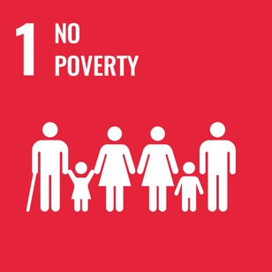
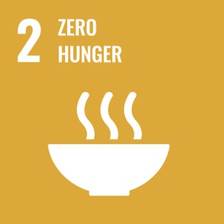

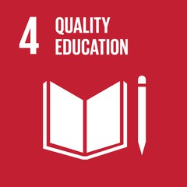

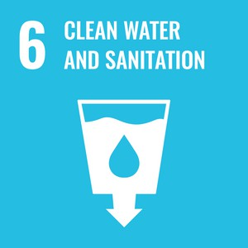


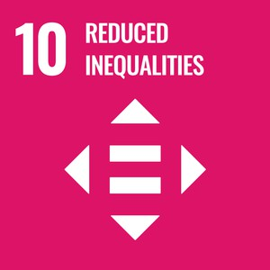
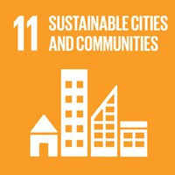

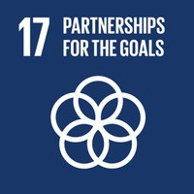
Contribution in SDG Goals
Human Relief Organization (HRO) Nepal is committed to fostering sustainable development and uplifting vulnerable communities through its impactful initiatives that align with the United Nations Sustainable Development Goals (SDGs). Our work across various sectors directly contributes to the realization of multiple SDGs:
Human Relief Organization Nepal sincerely acknowledges the unwavering support of our dedicated volunteers and community leaders. Your selfless contributions of time, effort, and influence play a vital role in advancing our mission and driving positive change.
We are deeply grateful for your continued commitment and for standing with us in our shared journey to build a stronger, more compassionate community.
7
8
9
10
11
12

Slide 23





Contact Us
To learn more about our organization, programs, and how you can get involved, please contact us at:
Human Relief Organization Nepal
Krishna Nagar Municipality, District: Kapilvastu,
Province: Lumbini, Nepal
Telephone: +977-76-520102
WhatsApp: +977-947040404
Email: info@hro.org,np
URL: http://www.hro.org,np/
Together, let's make a difference in the lives of those who need it most!

